Slide 1
Cloud Technology Fundaments 21UCA501

Slide 2
Virtual Appliances
Applications such as a Web server or database server that can run on a virtual machine image are referred to as virtual appliances. The name virtual appliance is a little misleading because it conjures up the image of a machine that serves a narrow purpose. Virtual appliances are software installed on virtual servers—application modules that are meant to run a particular machine instance or
image type. A virtual appliance is a platform instance. Therefore, virtual appliances occupy the middle of the cloud computing stack (refer to Figure 3.2).
A virtual appliance is a common deployment object in the cloud, and it is one area where there is considerable activity and innovation.

Slide 3
Virtual Appliances
One of the major advantages of a virtual appliance is that you can use the appliances as the basis for assembling more complex services, the appliance being one of your standardized components. Virtual appliances remove the need for application configuration and maintenance from your list of system management chores.

Slide 4
Virtual Appliances
You run across virtual appliances in IaaS systems such as Amazon’s Elastic Compute Cloud (EC2), which is discussed in detail. Amazon Machine Images are virtual appliances that have been packaged to run on the gird of Xen nodes that comprise the Amazon Web Service’s EC2 system.
Shown in Figure 3.4, the AMI library (http://developer.amazonwebservices.com/
connect/kbcategory.jspa?categoryID=171) includes a variety of operating systems both proprietary and open source, a set of enterprise applications such as Oracle BPM, SQL Server, and even complete application stacks such as LAMP (Linux, Apache, MySQL, and PHP). Amazon has negotiated licenses from these vendors that are part of your per-use pricing when you run these
applications on their servers.

Slide 5
Virtual Appliances
Virtual appliances are far easier to install and run than an application that you must set up yourself. However, virtual appliances are also much larger than the application themselves would be because they are usually bundled with the operating system on which they are meant to run. An application that is 50 or 100MB might require a virtual appliance that is 500MB to 1GB in size.
Usually, when a virtual appliance is created, the operating system is stripped of all excess functionality that isn’t required by the appliance, because the appliance is meant to be used as is.

Slide 6
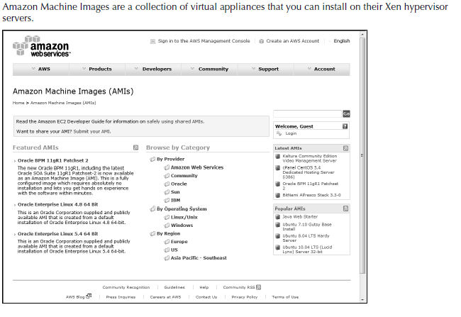
Virtual Appliances

Slide 7
Virtual Appliances
Virtual appliances have begun to affect the PC industry in much the same way that application stores have affected the cell phone industry. You can find various Web sites that either sell or distribute ready-to-use virtual appliances in various forms. Perhaps the best developed of these marketplaces is VMware’s Virtual Appliances site (http://www.vmware.com/appliances/) shown in Figure 3.5. These appliances are certified by VMware to be ready to use in the enterprise.

Slide 8
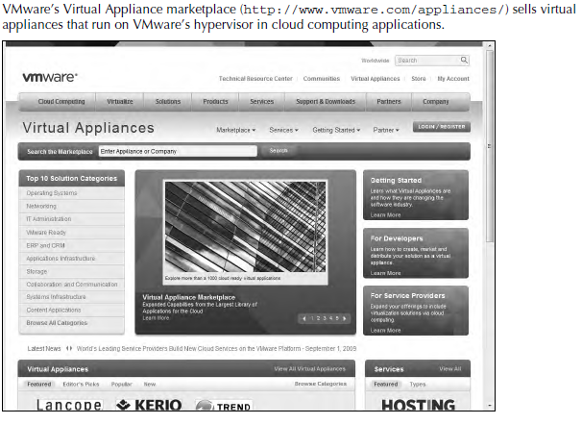
Virtual Appliances

Slide 9
THANK YOU

